Slide 1








YELP REVIEWS SENTIMENT CLASSIFICATION
Group 2

Slide 2





Our Team
Pranav Padhiyar
Pranav Amin
Rashmi Pujara
Glenn Shaji
Pinkush Gaba
Pratik Gupta
Pritesh Kanani
Diksha Shah
Zarna Devalia
Dhvanil
Shalmal Soni

Slide 3





Objectives & Dataset
Our dataset comprises of Yelp Dataset for businesses and user reviews, which will be used for performing sentiment analysis. The objectives are given below:
Identify the most positive and negative aspects of a business: By analyzing the reviews and ratings of a business on Yelp, you can identify the most positive and negative aspects of the business, such as the quality of service, food, or atmosphere.
Determine the most common complaints: By analyzing the reviews and ratings, you can determine the most common complaints that customers have about a business. This information can help the business improve and address the issues that customers are unhappy about.
Analyze customer satisfaction over time: By analyzing the data over time, you can see if customer satisfaction has improved or declined, and identify factors that may have contributed to these changes.
Identify trends and patterns: By analyzing the data, you can identify trends and patterns in customer sentiment, such as changes in customer preferences or attitudes over time.
Compare sentiment across different businesses: By comparing the sentiment of different businesses, you can identify which businesses are doing well and which are not, and determine what factors contribute to this.

Slide 4
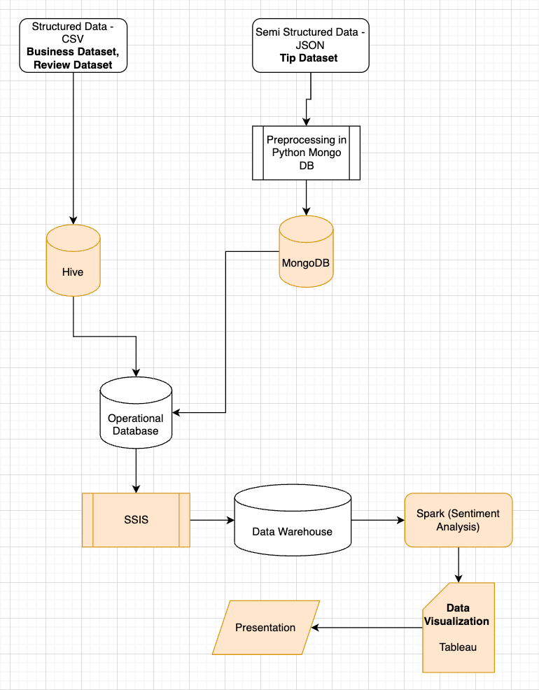


Process Flow
The process flow comprises of the following Big Data tools:
MongoDB (Semi-Structured Data - JSON)
Hive (Structured Data - CSV)
SSIS - ETL (Visual Studio)
Data Warehouse (SQL Server Management Studio)
Tableau (Visualization)
Apache Spark (used for performing sentiment analysis
using Databricks)

Slide 5
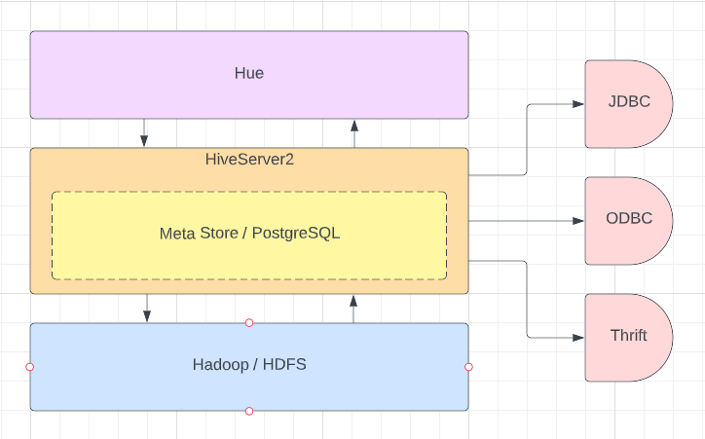
Data Storage Architecture
Hadoop provides distributed storage for Hive Database
Hue provides User Interface to interact with Hive database
Hive also provides various connection adaptors to interact with it, such as, JDBC, ODBC and Thrift

Slide 6
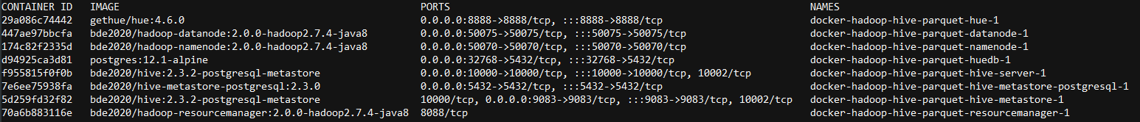
Implementing Storage architecture in Docker
Storage architecture has been created using "docker compose"
After deploying it on Azure Virtual Machine, We exposed "8888" port to excess Hue Interface from outside.
Structured CSV files will be loaded using Hue Interface

Slide 7

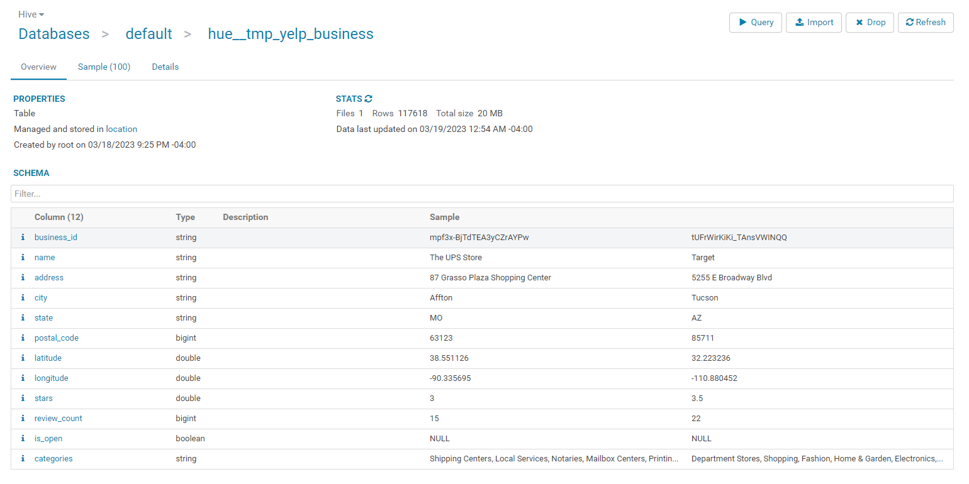
Yelp Business - Table

Slide 8
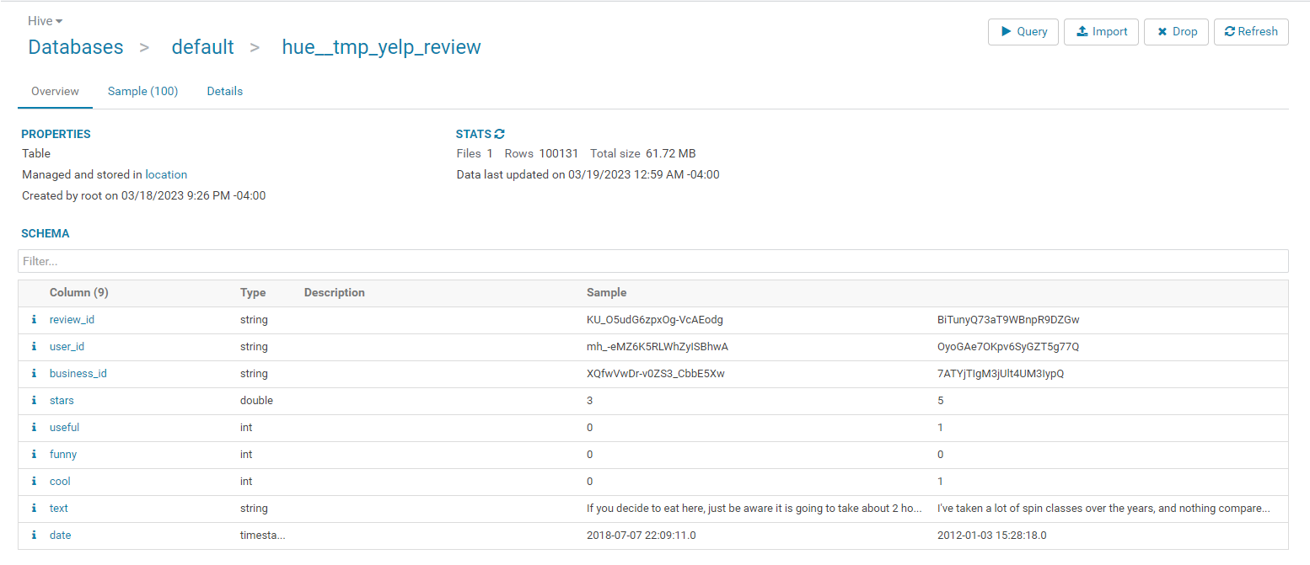
Yelp Review - Table

Slide 9
Why MongoDB ?
MongoDB is often considered a semi-structured or flexible schema database because it allows for dynamic, non-relational data structures. While traditional relational databases require data to be structured into tables with predefined columns and data types, MongoDB allows for data to be stored as JSON-like documents that can have a dynamic schema.
In MongoDB, documents within a collection can have different fields and data types, and new fields can be added or removed without requiring any predefined schema. This flexible schema makes MongoDB an excellent choice for managing semi-structured data, such as JSON data from web applications, sensor data from the Internet of Things (IoT), or log files from various sources.

Slide 10
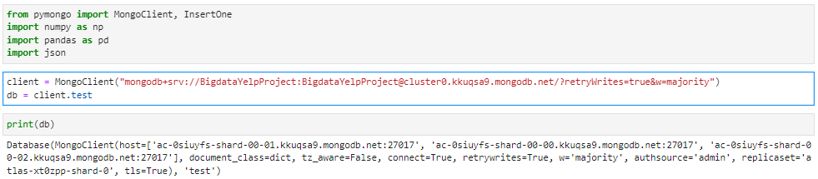
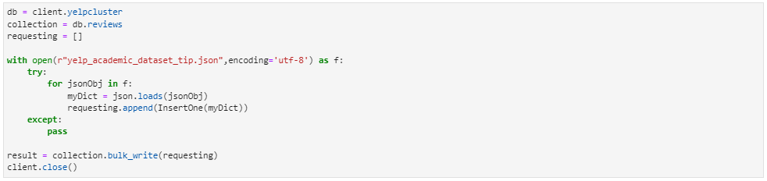
Using Python to connect to Mongo DB Cluster
Uploading JSON data to cluster

Slide 11
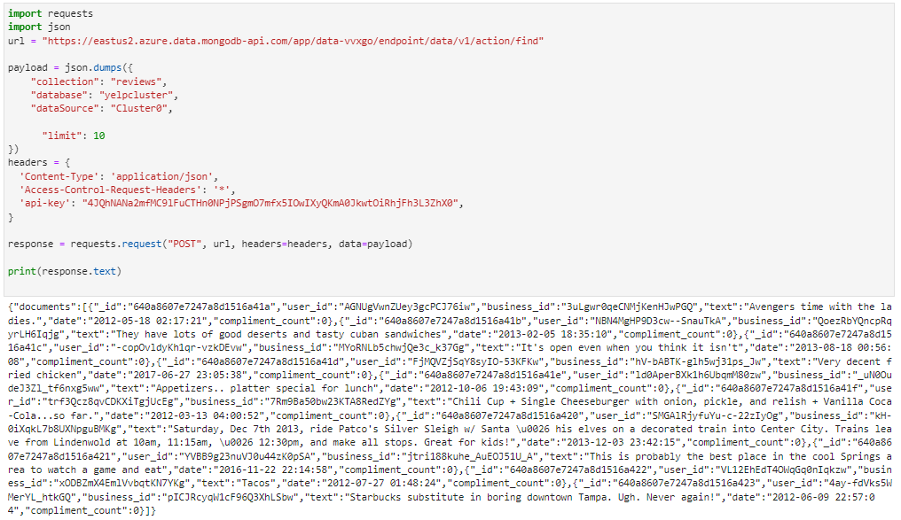
Calling Mongo DB API to check data connection

Slide 12
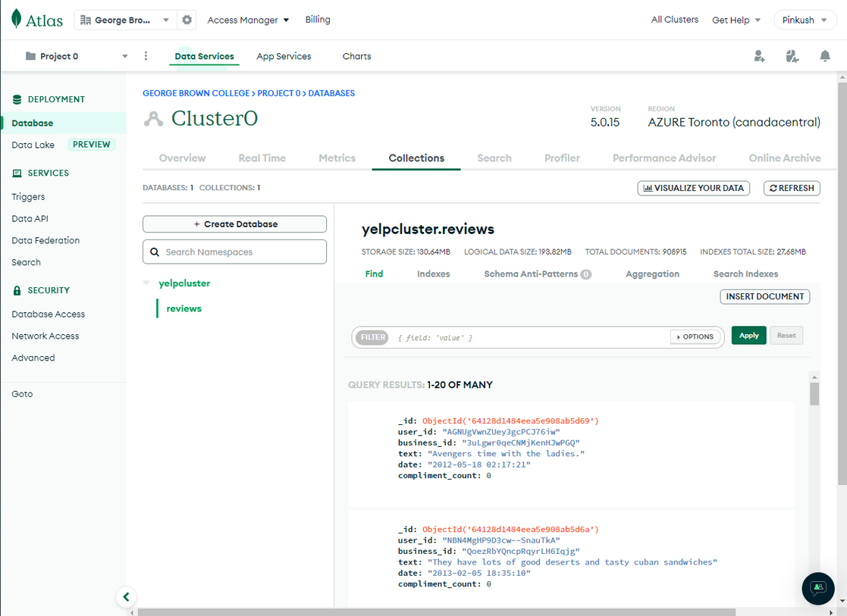
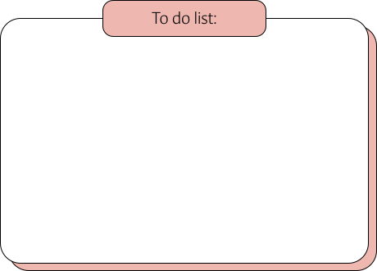
Mongo DB Cluster
Tip Dataset Fields:
business_id : string, 22 character business id, maps to business in business.json
text : string, text of the tip
date : string, when the tip was written, formatted like YYYY-MM-DD
user_id : string, 22 character unique user id, maps to the user in user.json
compliment_count : integer, how many compliments it has

Slide 13
SSIS-ETL
SSIS (SQL Server Integration Services) is a tool provided by Microsoft as a part of the SQL Server suite to perform ETL (Extract, Transform, Load) operations.
ETL is a data integration process used to extract data from multiple sources, transform it into a format that can be used by business applications, and load it into a target database or data warehouse. ETL is a critical process in data integration and is used by organizations to ensure the quality and consistency of data across multiple systems.
SSIS provides a graphical user interface to design and implement ETL workflows, making it easier to manage complex data integration scenarios. SSIS supports a wide range of data sources, including SQL Server databases, Oracle databases, flat files, Excel spreadsheets, and web services. It also provides a variety of data transformation tools to clean, aggregate, merge, and transform data as needed

Slide 14
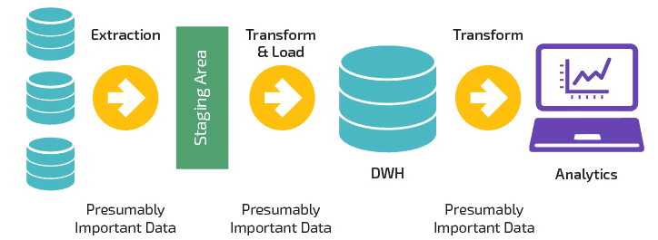
SSIS-ETL
SSIS can be used to automate ETL processes, schedule workflows, and monitor performance. It can also be integrated with other tools and technologies in the Microsoft ecosystem, such as SQL Server Analysis Services (SSAS) and SQL Server Reporting Services (SSRS), to create end-to-end data integration and reporting solutions.
Overall, SSIS is a powerful tool for ETL operations and can help organizations to improve the quality and consistency of data across multiple systems, automate data integration processes, and reduce manual effort and errors.

Slide 15
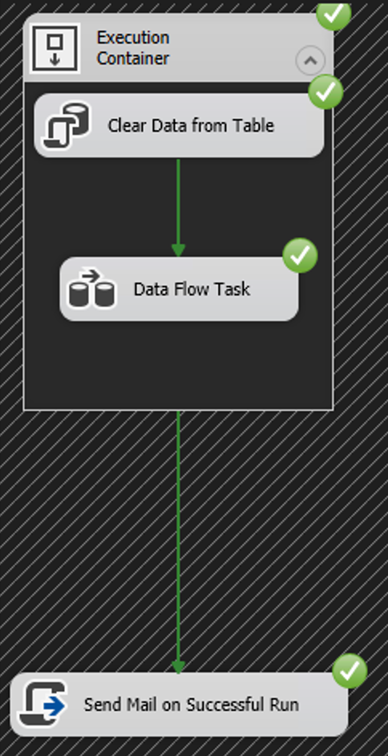

SSIS - Visual Studio
Below are the different modules we've used in control flow:
Execution container to give structure and control the flow of tasks and data in SSIS
Clear existing data from the table in SQL
Data Flow Task (contains all the ETL operations)
Send mail for notification on completion of SSIS Pipeline

Slide 16
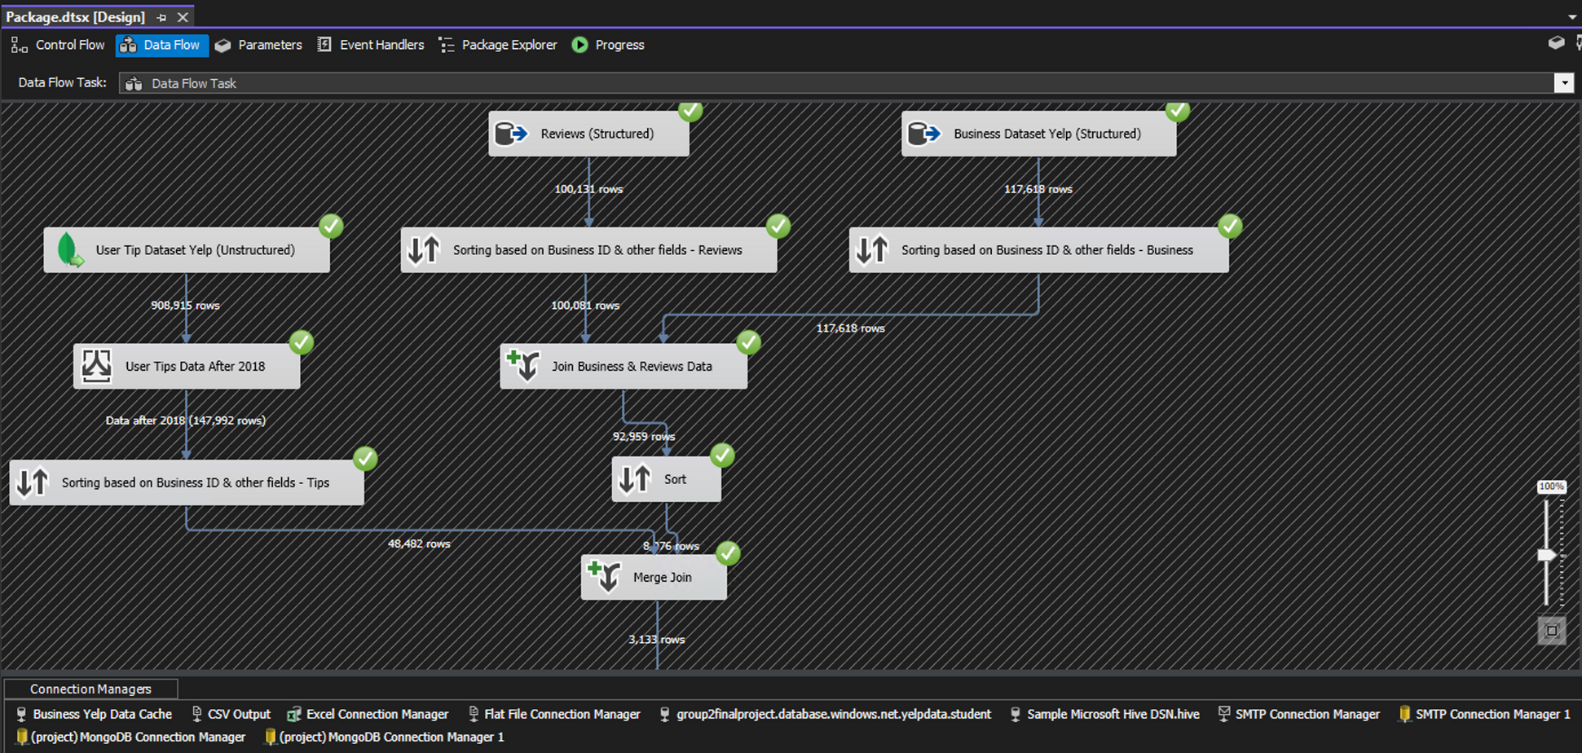
SSIS - Visual Studio
Overall, the following steps are being performed in given screenshot
Data is coming in from MongoDB & Hive
We sort them based on business id and few other fields, filter data from MongoDB because of huge data size
Join structured data and then re-sort and merge with semi-structured data

Slide 17
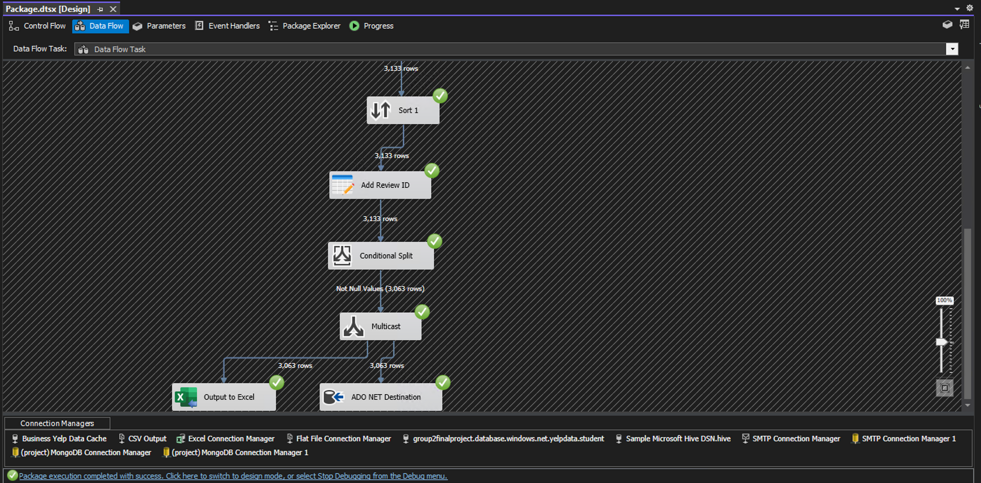
SSIS - Visual Studio
Overall, the following steps are being performed in given screenshot
Sort data after all the joins
Give a unique id 'review_id' to the final dataset
Use multicast to output dataset to excel worksheet as well as ADO NET Destination which is a sql table hosted on Azure database

Slide 18
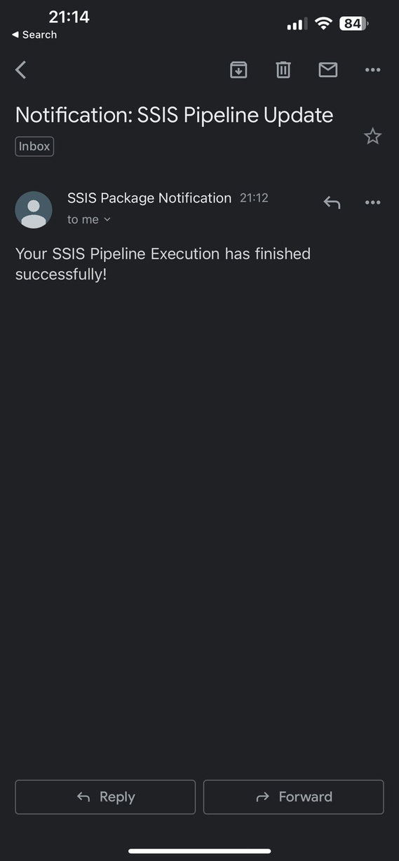
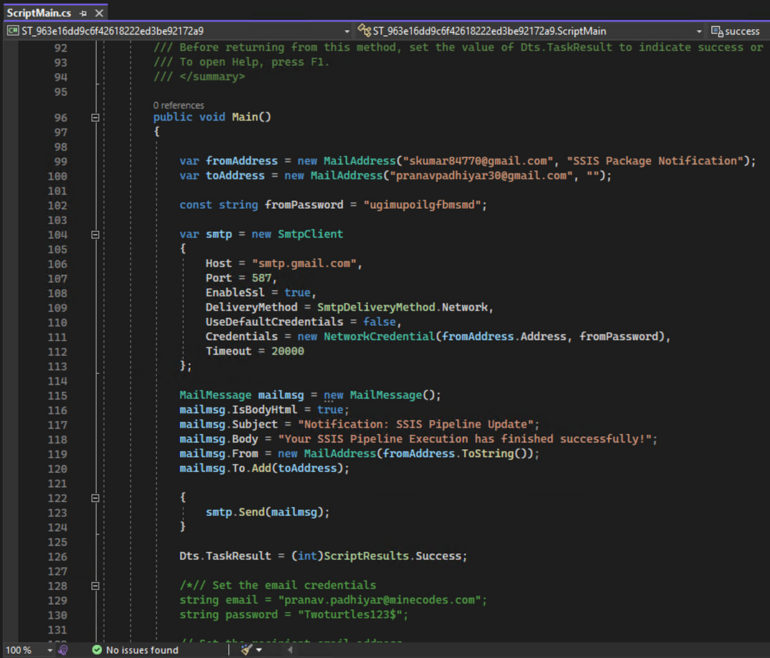
SSIS - Visual Studio
Finally after the completion of SSIS Pipeline, an email(Script created on C#) is triggered notifying developer that the execution is completed
(This can be extremely useful when the dataset is huge and it takes a lot of time for the pipeline to get completed, in our case it was just 3-4 minutes max)

Slide 19
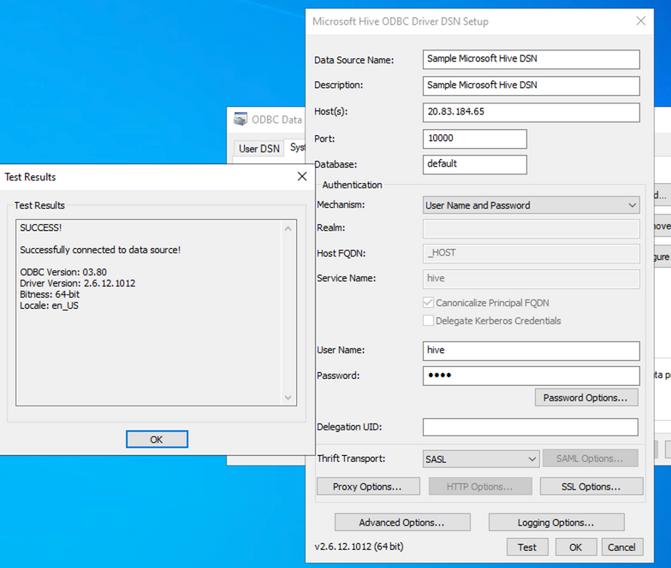
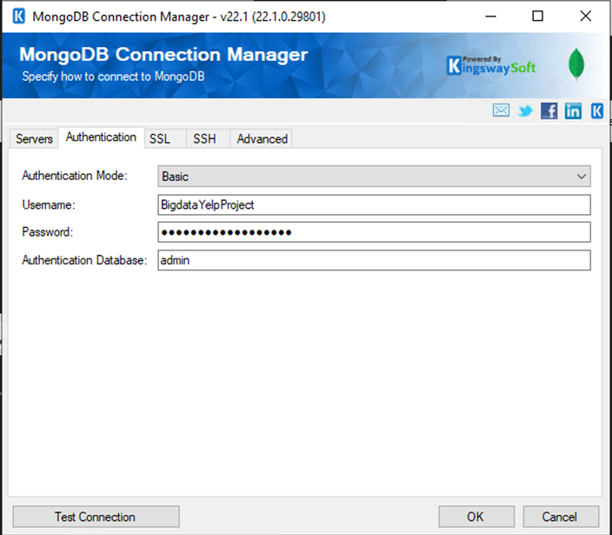
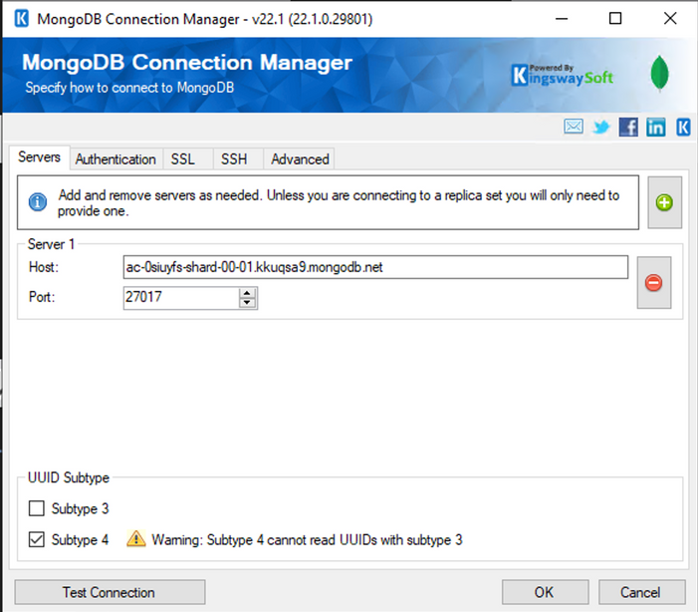
SSIS - Visual Studio
Mongo DB Connection Manager Settings
Hive ODBC Driver Connection Settings

Slide 20
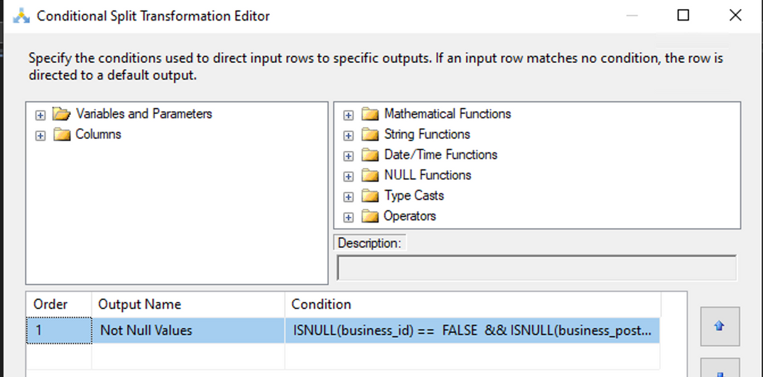
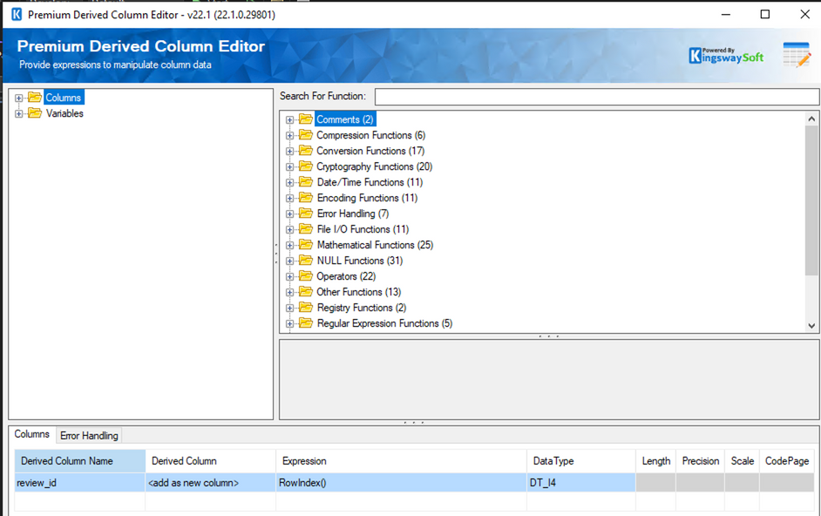
SSIS - Visual Studio
Filtering Null Values from all fields
Adding review_id column

Slide 21


Data Warehouse
A data warehouse is a large, centralized repository of data that is used for reporting, analysis, and business intelligence purposes. It is designed to support decision-making by providing a single source of accurate, consistent, and integrated data.
Once the data has been loaded into the data warehouse using SSIS, the data warehouse can perform various operations on the data to make it usable for reporting and analysis. These operations can include:
Data cleaning and quality control
Data modeling
Data aggregation and summarization
Data security
Data querying and reporting

Slide 22
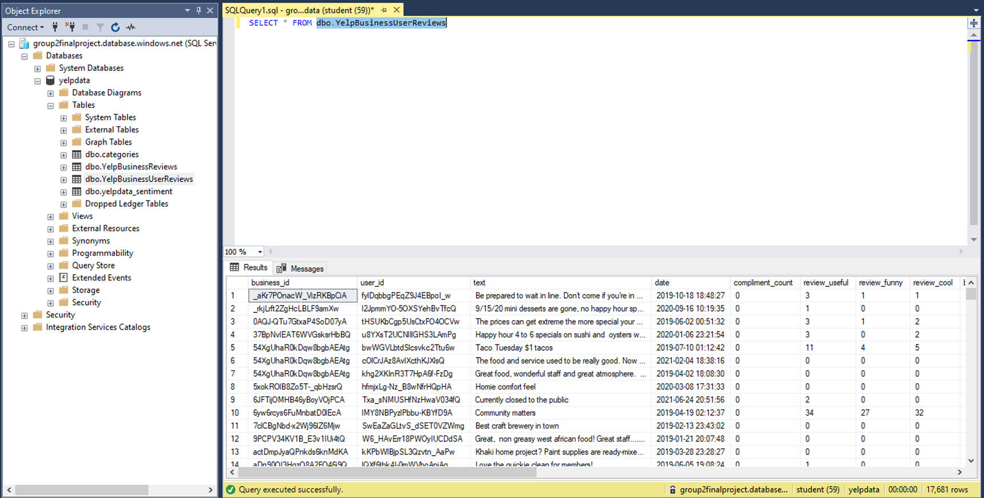
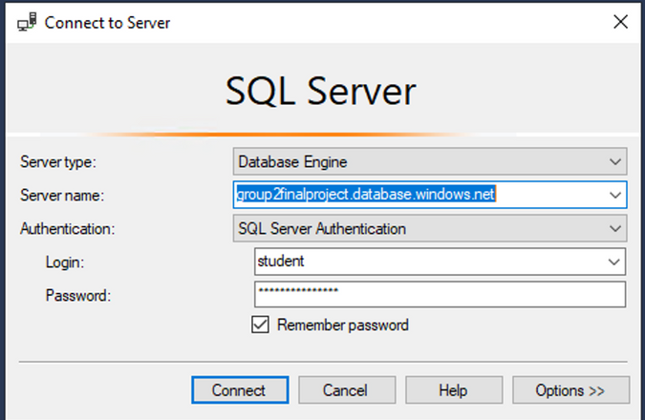
Tables Created in SQL Database (Accessible via SQL Server Management)
Final SQL table after SSIS pipeline:
dbo.YelpBusinessUserReviews

Slide 23
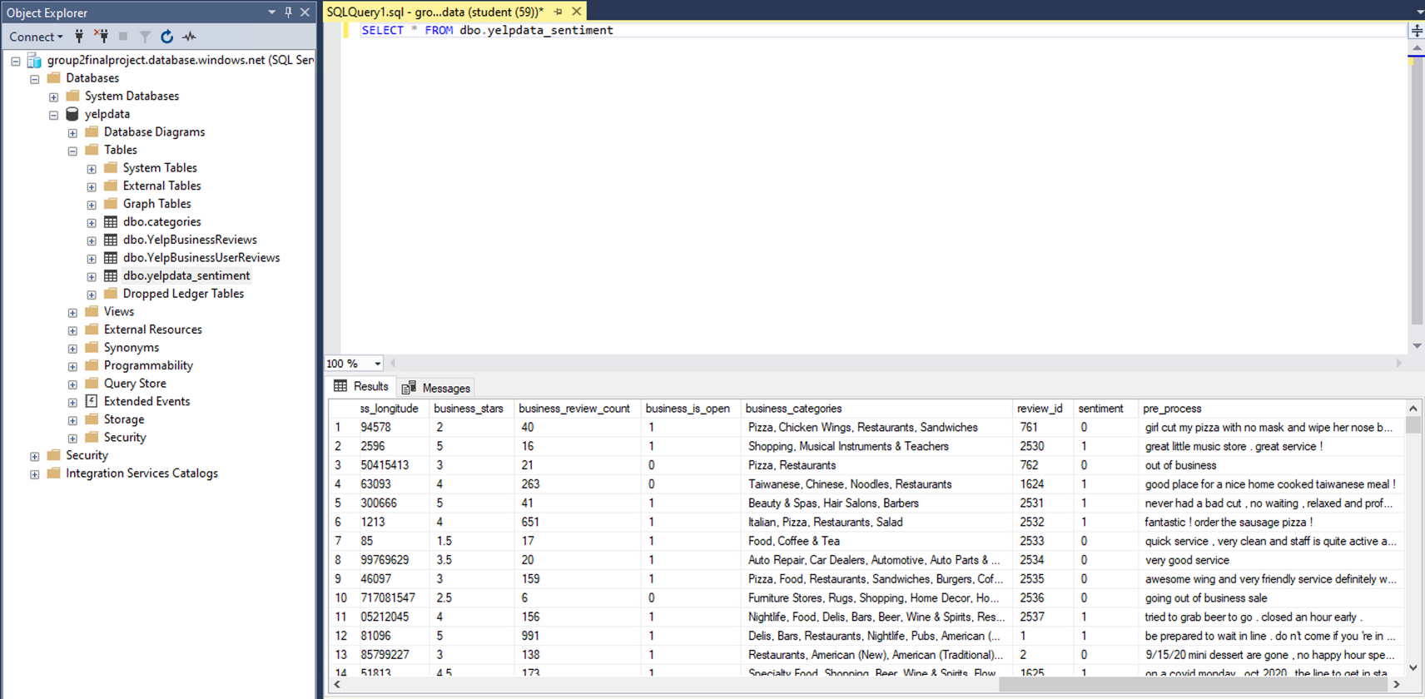
Tables Created in SQL Database (Accessible via SQL Server Management)
SQL table created using Spark in Azure Databricks while doing Sentiment Analysis

Slide 24

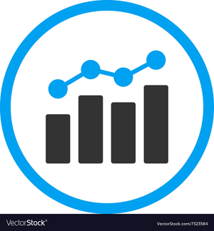

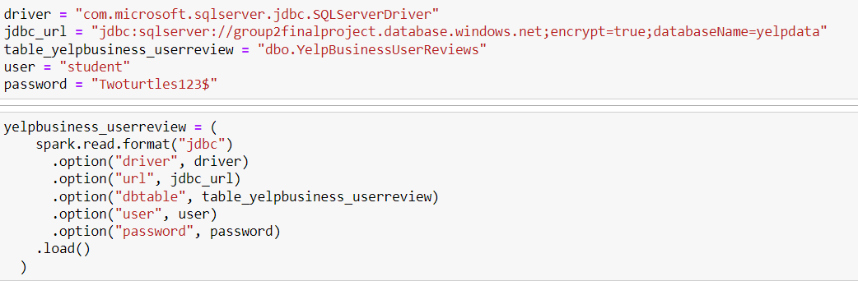
Spark Process
JDBC
Azure Databricks is a Cloud-based big data processing and analytics platform that allows users to run Apache spark applications.
To use JDBC (Java Database Connectivity) Connection, we need JDBC URL, driver class name, username, and password of the database.
Data can be loaded into a Spark DataFrame and can be processed after transforming into Pandas DataFrame.
Data can be written to Database as well.
SSMS

Slide 25
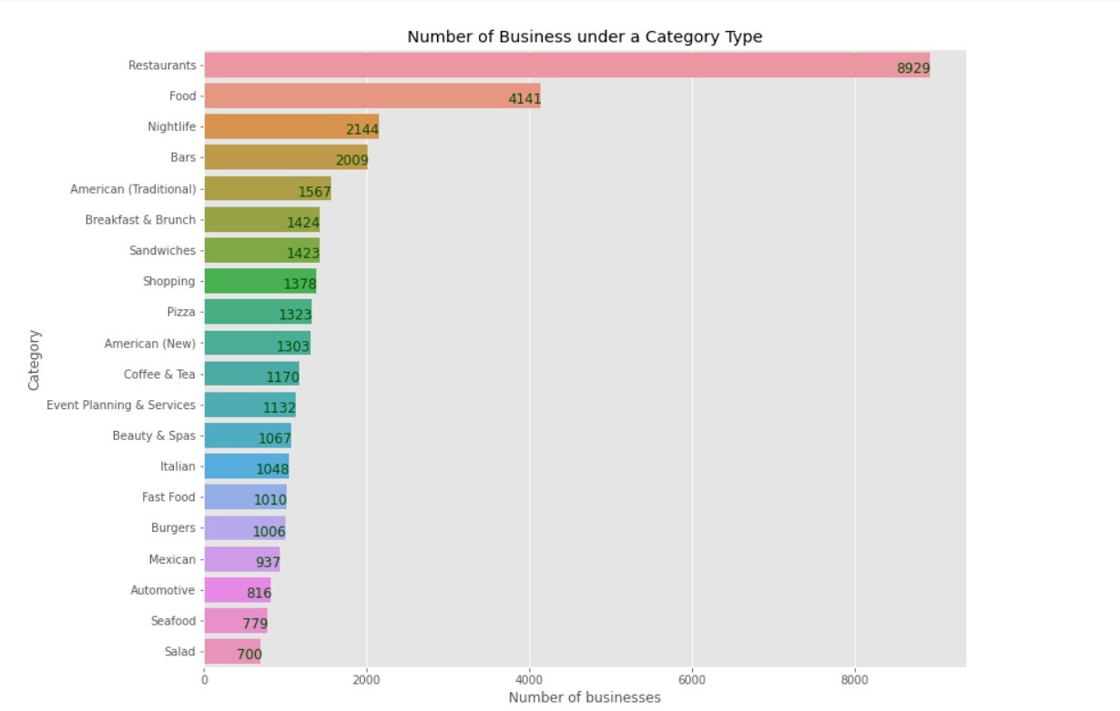
Visualization using Spark
After pre-processing, We separated categories into different businesses and plotted it against review count.

Slide 26
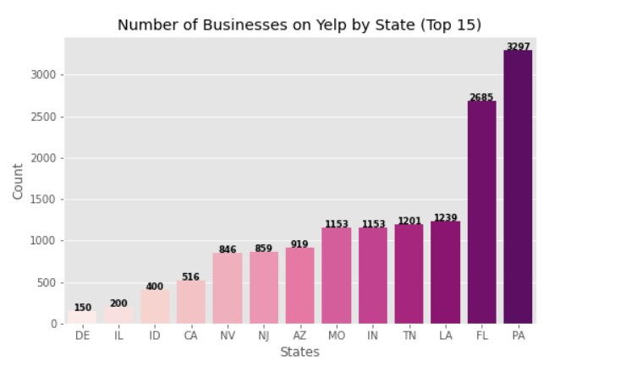
Visualization using Spark
We also looked at the number of business in different states.

Slide 27
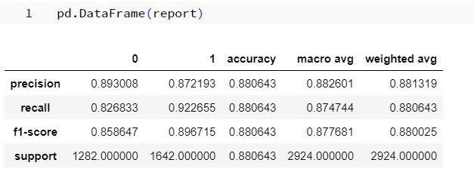
Accuracy of the Sentiment Analysis Model
Review text was tokenized, removed contractions, removed stop words and lemmatized. Using LinearSVC, the accuracy of the sentiment analysis model is 88%.

Slide 28
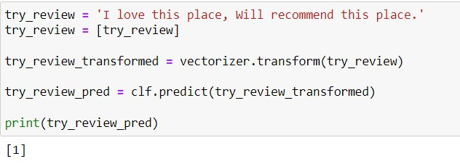
Sentiment Analysis - Positive Prediction
Positive review was tested against sentiment analysis model, which predicted correct output.

Slide 29
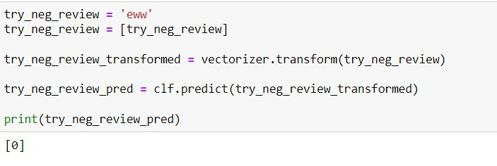
Sentiment Analysis - Negative Prediction
Negative review was tested against sentiment analysis modes, which predicted correct output.

Slide 30
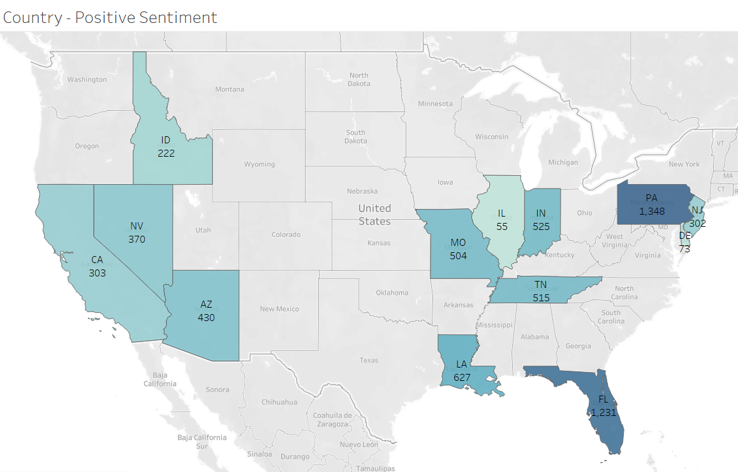
Country wise Positive Reviews
After Sentiment analysis, Tableau was used to plot country wise positive reviews.

Slide 31
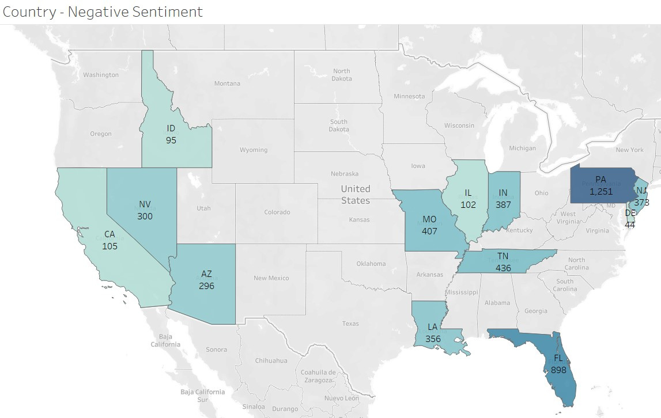
Country wise Negative Reviews
We also plotted country wise negative reviews.

Slide 32
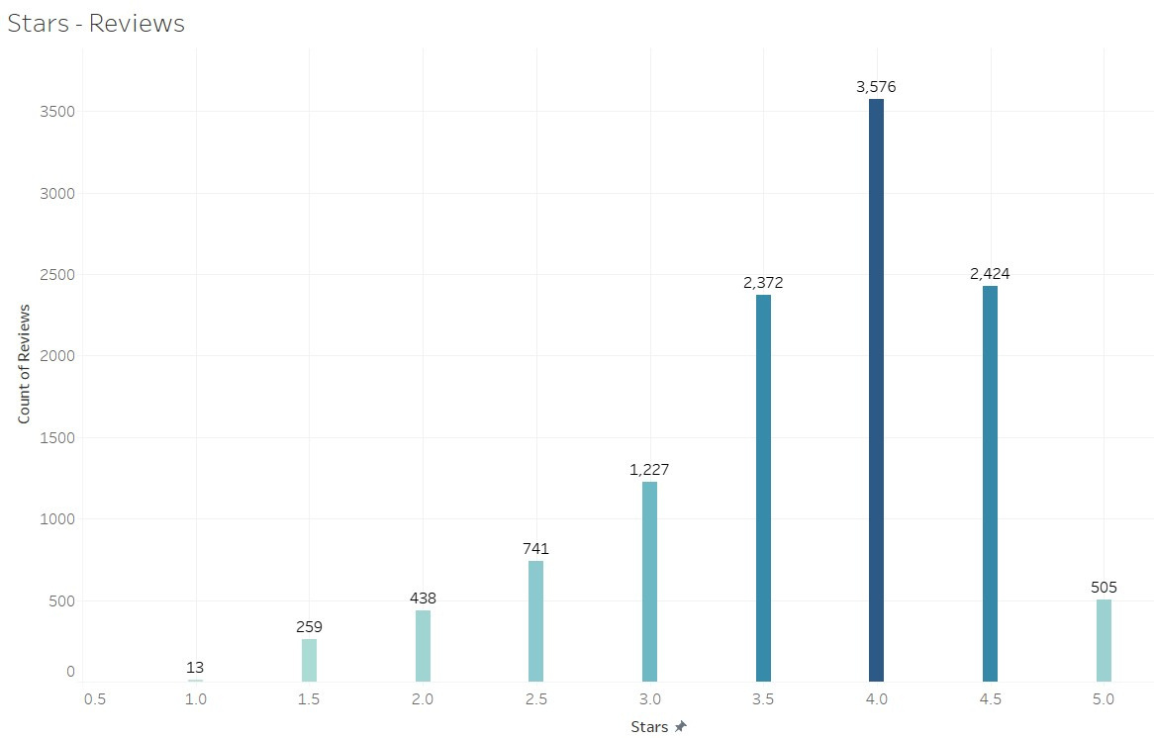
Stars wise Review Count
The graph shows most of the businesses got 4 stars.

Slide 33
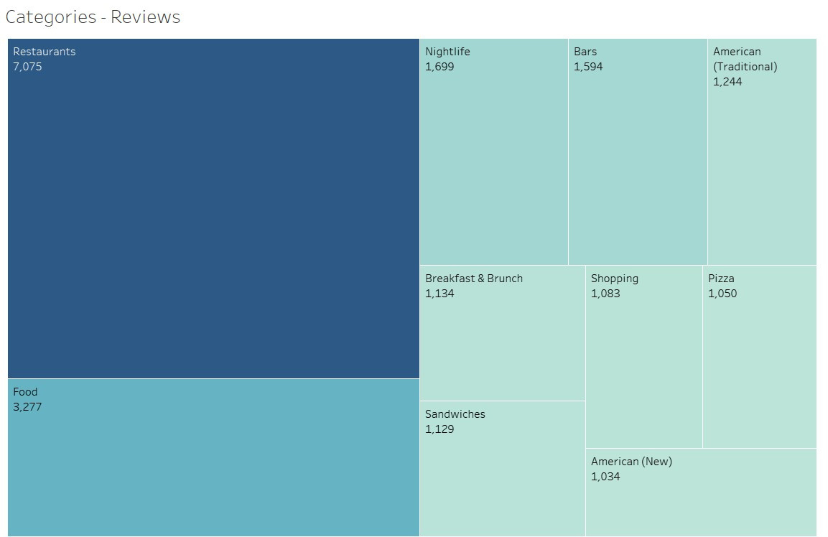
Categories wise Review Count
As per the visualization, it seems mostly Yelp reviews are for restaurants and food categories.

Slide 34



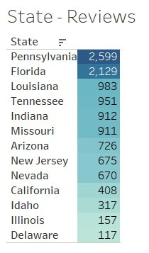




State wise Review Count
Pennsylvania seems to have the most of the reviewers on Yelp.

Slide 35
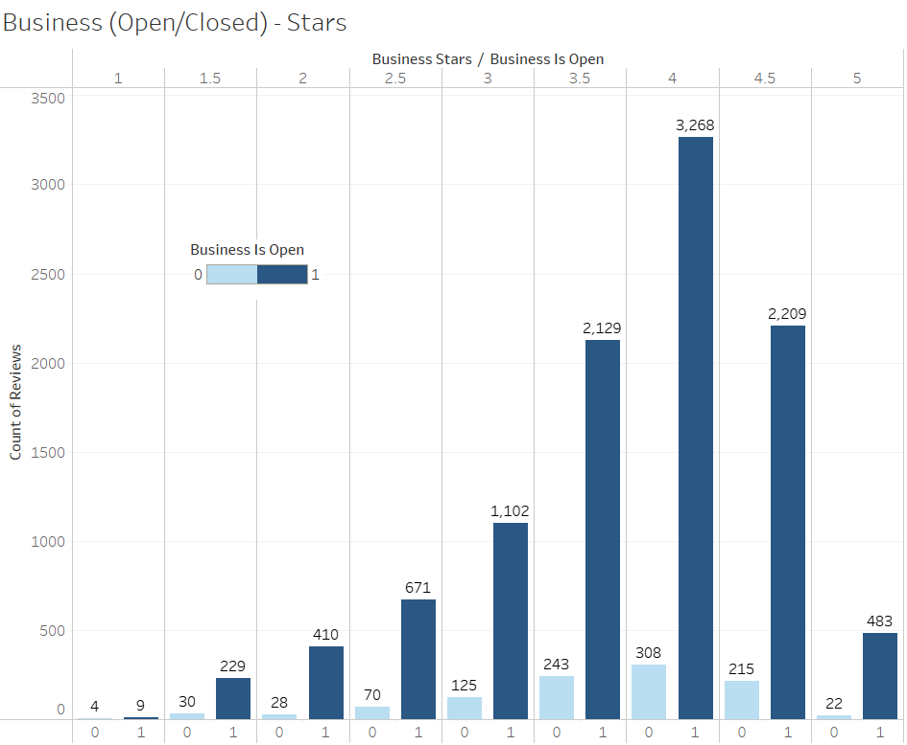
Status (Open/Closed) & Stars
In Tableau, we plotted businesses' status whether it is open or closed. And we visualized it with stars.

Slide 36


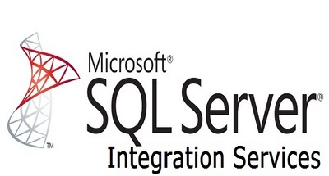


Conclusion
We deployed a Yelp Review Sentiment Classification Analysis using Big Data Tools and Techniques:
Mongo DB
Hive
SSIS
SSMS
Spark
Tableau

Slide 37






